Slide 1


1
Excel Pivot Table
Presented by: Data Team

Slide 2
Excel Pivot Table
Pivot table is one of Excel's most powerful features. It is a data summarization tool that allows you to extract a dynamic summary report from a large data set.
Pivot tables are used to summarize, sort, reorganize, group, count, total or average data stored in a spreadsheet.

Slide 3
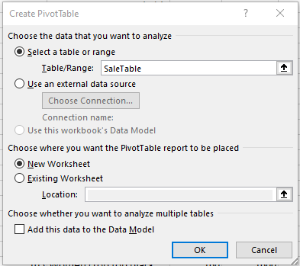
Creating a Pivot Table Manually
Click Insert then Pivot table

Slide 4
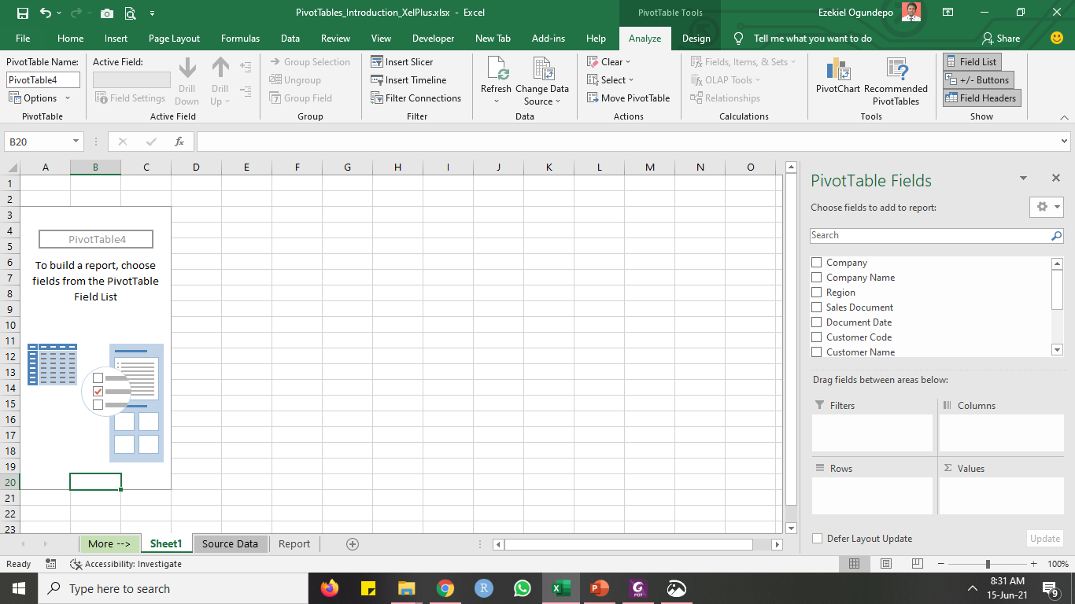
Creating a Pivot Table Manually

Slide 5

Lab session

Slide 6


Thank You

